Slide 1
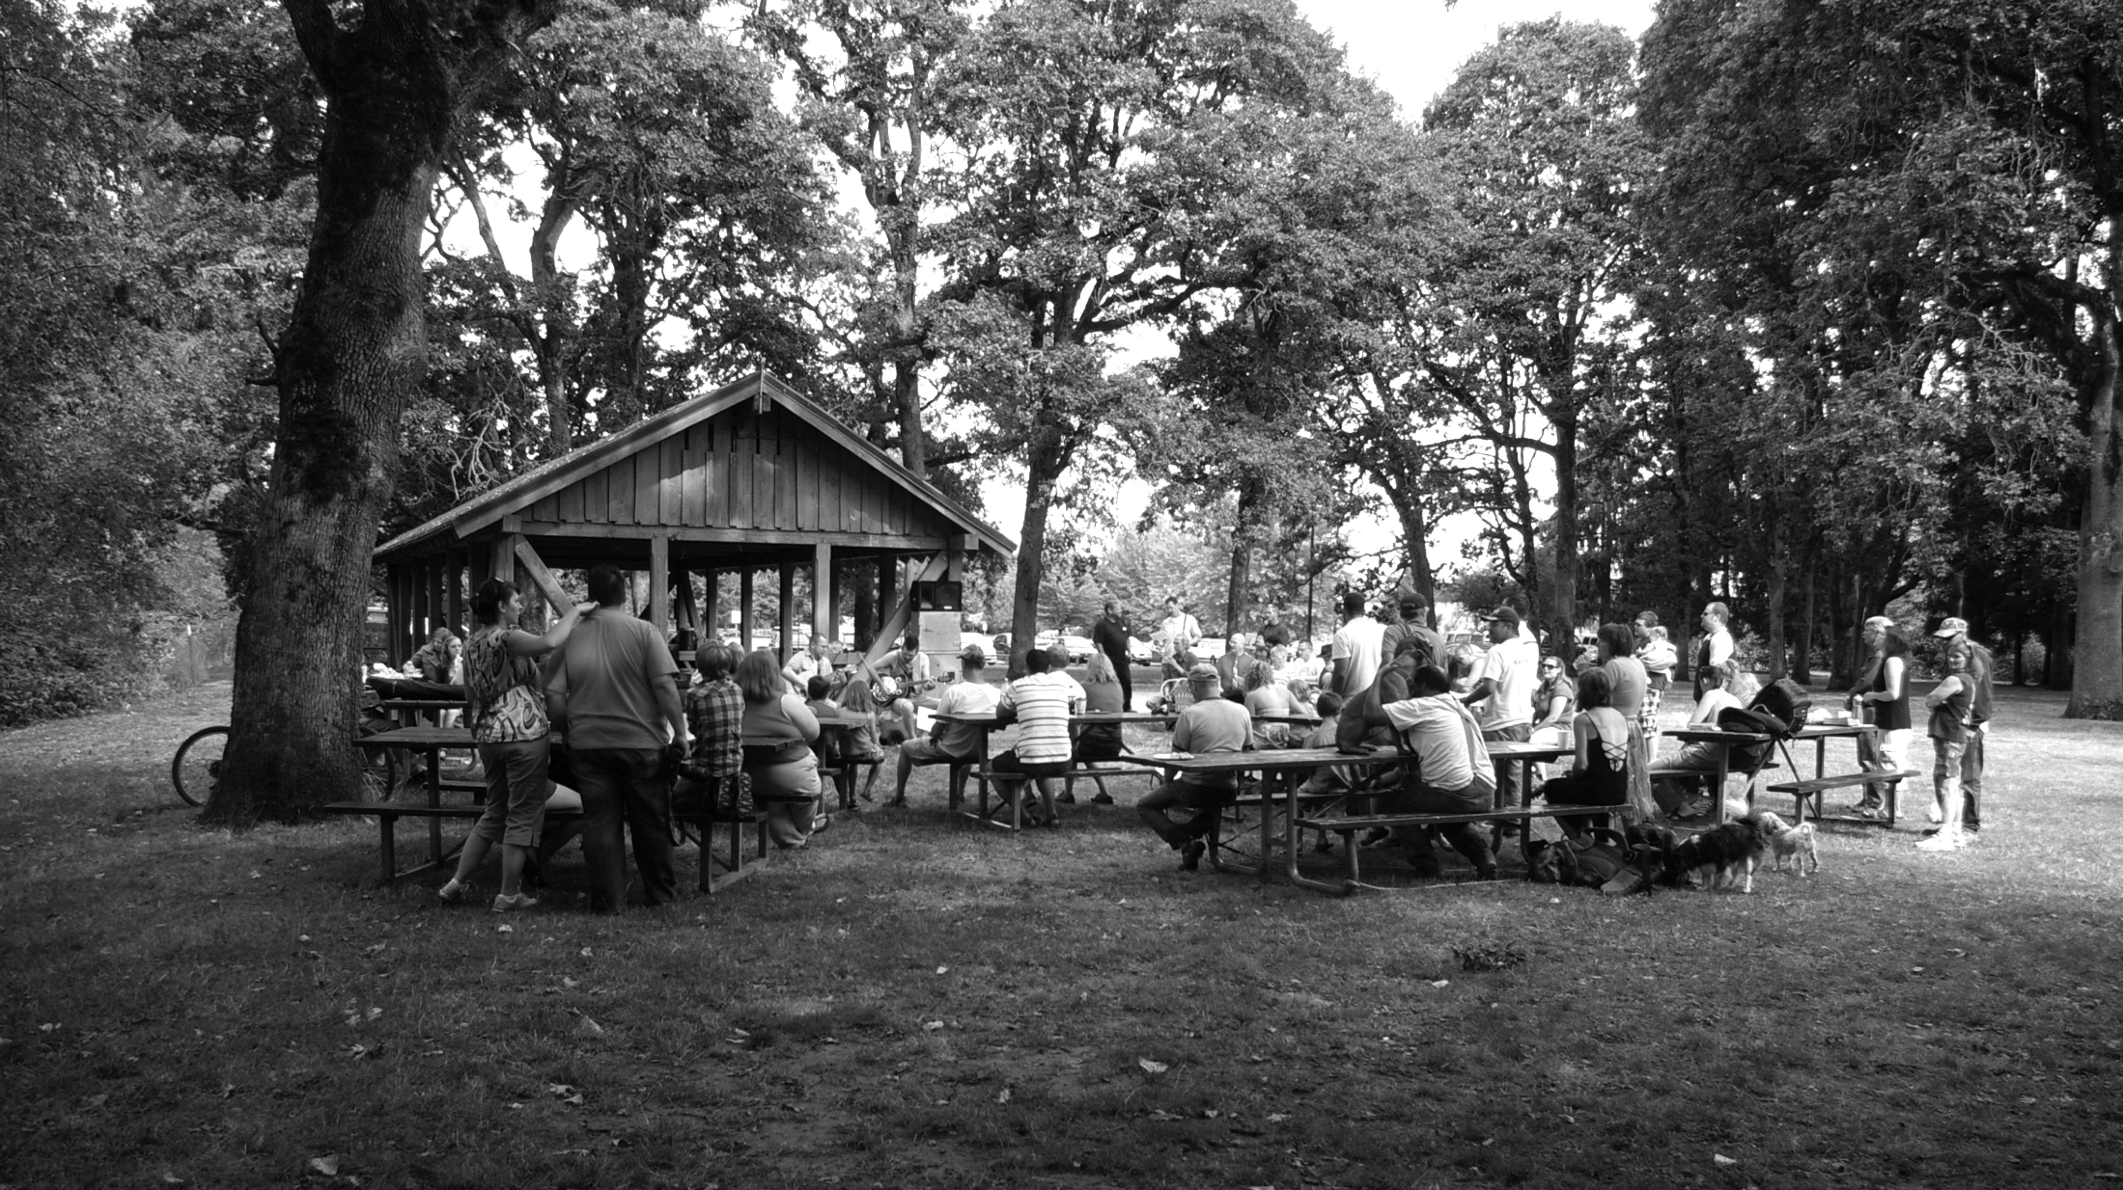

Slide 2
Luke 14
¹² Then Jesus said to his host, ‘When you give a luncheon or dinner, do not invite your friends, your brothers or sisters, your relatives, or your rich neighbors; if you do, they may invite you back and so you will be repaid. ¹³ But when you give a banquet, invite the poor, the crippled, the lame, the blind, ¹⁴ and you will be blessed. Although they cannot repay you, you will be repaid at the resurrection of the righteous.’

Slide 3
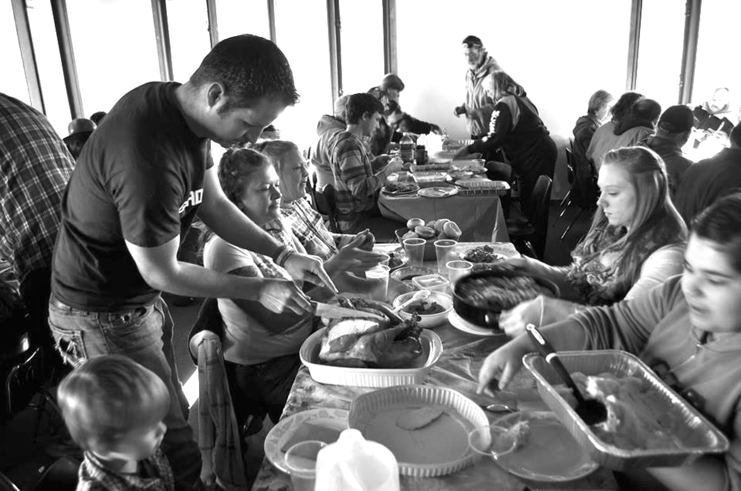
To RESTORE DIGNITY and relieve hunger through SHARED MEALS
Leviticus 23
Matthew 6:11; 26:17-30
Acts 2:46-47

Slide 4
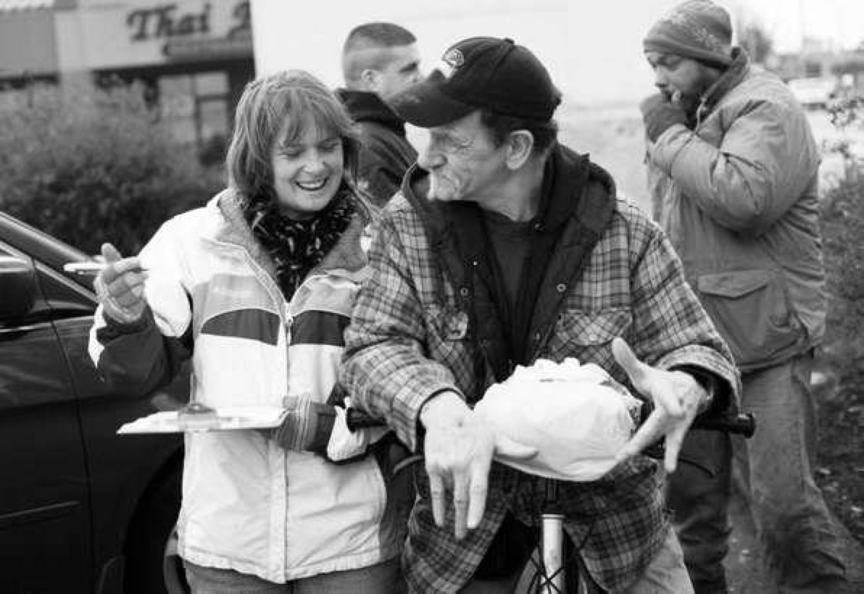
To intentionally LISTEN to the stories of those who are experiencing homelessness, looking for opportunities to affirm strengths and discover motivations
Mark 1:35-37
John 16:7-15
Hebrews 1:1-3

Slide 5
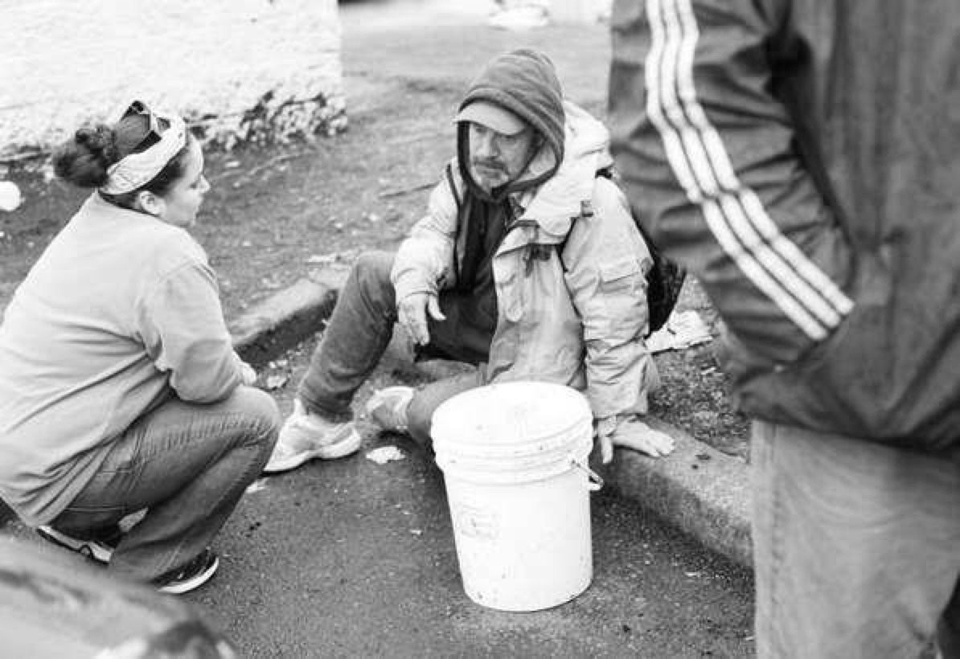
To SHARE with others so they may IDENTIFY with our story – giving them the ability to feel safe and able to trust in relationship
Genesis 1:1-2;
John 1:1; Psalm 1
2 Timothy 3:16-17

Slide 6
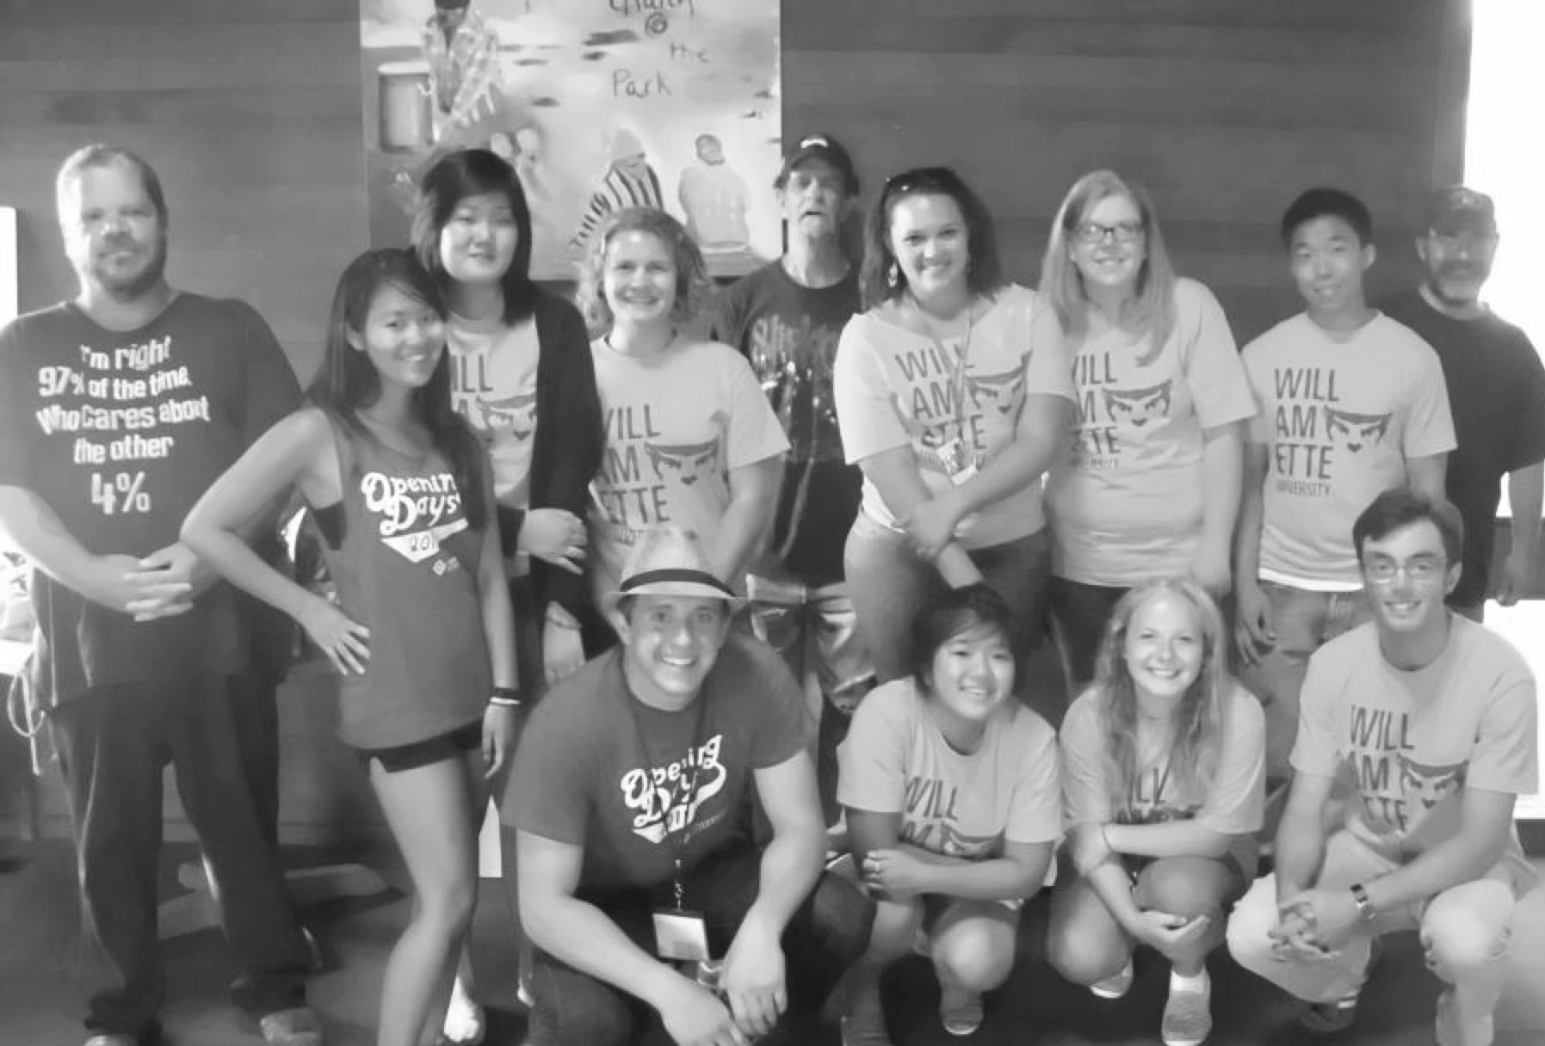
To INVITE all who join us to SERVANTHOOD and leadership
Genesis 12:1-3;
Ephesians 1:22-23;
2:8-10
1 Peter 2:12

Slide 7
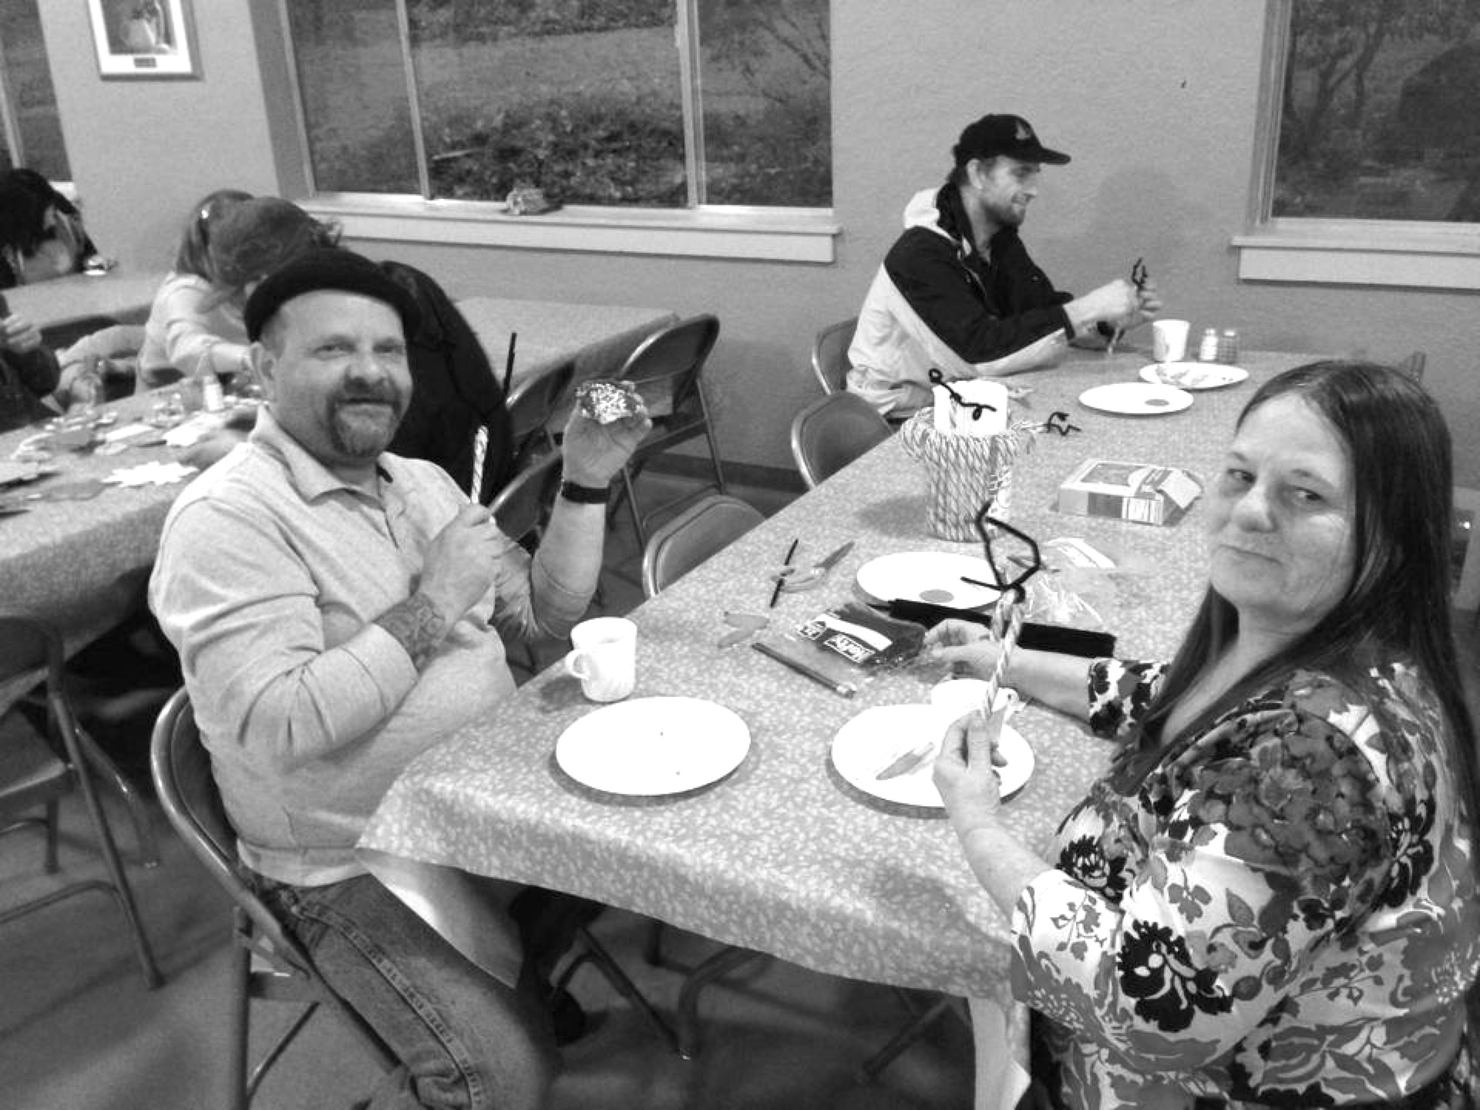
To meet critical needs of shelter and clothing through RELATIONAL PARTNERSHIPS
John 2
Hebrews 10:24-25
Leviticus 23
Acts 2:42-47

Slide 9
Blessings of overwhelming peace & hope for each guest
For each volunteer – may we be people that share the love & peace of Christ
Good health & safety throughout the event

Slide 10
150 people @ $50 per person
Checks payable to Church@thePark, MEMO: “Room in the Inn”
Cash & credit card donations can be accepted today
Welcome Bags (practical gifts, 150 needed)
See Gabi for instructions today!

Slide 11
Serve & share one of the 4 family-style meals
Kitchen & Dining Hall cleanup
Setup & cleanup of the Camp
Participate in or plan a relationship-building activity

